Slide 1

UPSC EXAM PREPARATION SITE !
Sagar Mane:- 23106032
Rajanya Kshatriya:- 23106096
Bhagya Gandhi:- 23106101
Sarvesh Bhartu:- 23106055
Project Guide
Prof. Monali Korde
Academic year 2024-25
Notes:
1

Slide 2
Outline
Introduction
Literature Survey
Problem Statement
System Design
Technologies and Methodologies
Implementation Screenshots
Conclusion
References

Slide 3
Introduction
The platform is designed to assist UPSC aspirants with structured study materials, interactive tools, and essential resources. The website provides current affairs updates, mock tests, PYQs, and syllabus tracking, ensuring holistic preparation. E-learning fulfills the thirst of knowledge and features offers online content that can be delivered for the learner at anywhere. Personalized dashboards, AI-driven recommendations, and progress tracking help cater to individual learning styles effectively.
Notes:
3

Slide 4
Literature Survey
Table 1 : Literature Survey
Paper Title | Advantages | Disadvantages | Technologies Used
Gamification and AI: Enhancing User Engagement through Intelligent Systems (2024) | Improves engagement with AI-driven gamification Personalizes learning experiences | Complex implementation Requires continuous monitoring | Artificial Intelligence Gamification frameworks
Adaptive Learning Using Artificial Intelligence in e-Learning: A Literature Review (2024) | Reviews AI’s role in adaptive learning Identifies key challenges | Limited empirical data No new experiments | Artificial Intelligence Machine Learning
Gamified AI-Driven Assessments (2024) | Enhances engagement in assessments Improves evaluation accuracy | AI bias risk Needs strong infrastructure | Artificial Intelligence Gamification elements
Leveraging AI in E-Learning: Personalized Learning and Adaptive Assessment through Cognitive Neuropsychology—A Systematic Analysis (2024) | Uses AI for personalized learning Enhances adaptive assessments | Ethical concerns AI bias issues | Artificial Intelligence Adaptive Learning Systems
Analysing the Impact of Gamification Techniques on Enhancing Learner Engagement, Motivation, and Knowledge Retention: A Structural Equation Modelling Approach (2024) | Boosts motivation and engagement Improves knowledge retention | Overfocus on competition Learning differences not addressed | Gamification techniques Structural Equation Modeling

Slide 5

Problem statement
UPSC aspirants face challenges such as lack of access to organized study materials, inefficient time management, and limited opportunities for personalized guidance. There is a need for a comprehensive, user-friendly website that provides curated resources, mock tests and progress tracking to streamline and enhance the preparation process.

Slide 6
Overview of System Design
Homepage Components:
Login page.
Select exam.
Subject selection
AI Chatbot
Quiz section
PYQ section.
Mock test section(To track performance)
Notes:
6

Slide 7
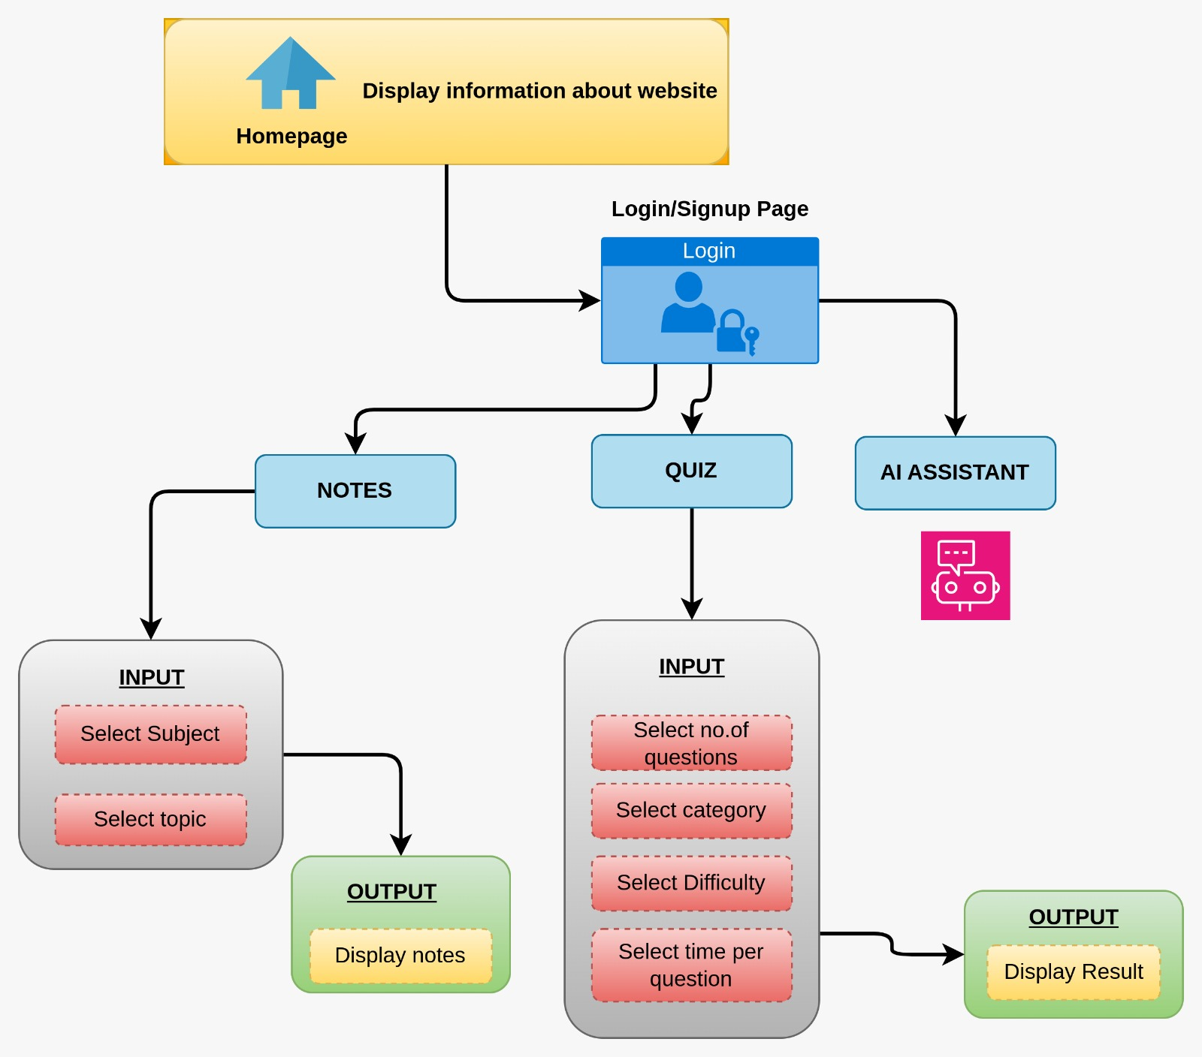
Fig. 1 : Block diagram of proposed system

Slide 8
User Authentication & Login System
Secure login and registration using MySQL.
Exam Selection Module
Users select the desired UPSC exam category (Prelims, Mains, Optional).
Subject Selection & Study Material
Organized subject-wise syllabus with categorized study resources.
AI Chatbot Assistance
AI-driven chatbot for instant query resolution.
5. Quiz Section
Topic-wise quizzes with instant feedback.
7. Database & Cloud Storage
Setting up a local web development environment using XAMPP, which
includes Apache (web server) and MySQL (database server) to manage user
credentials.

Slide 9
Technology Stack
Frontend: HTML, CSS and Javascript → Building the graphical user interface (GUI) with HTML for structure, CSS for styling and Javascript for interactivity, ensuring simplicity and responsiveness. Backend: PHP → Handles the backend by processing data, managing user authentication, and interacting with MySQL, ensuring robustness and compatibility across platforms. Database: MySQL → Acts as the database to store and retrieve user credentials.
Notes:
9

Slide 10
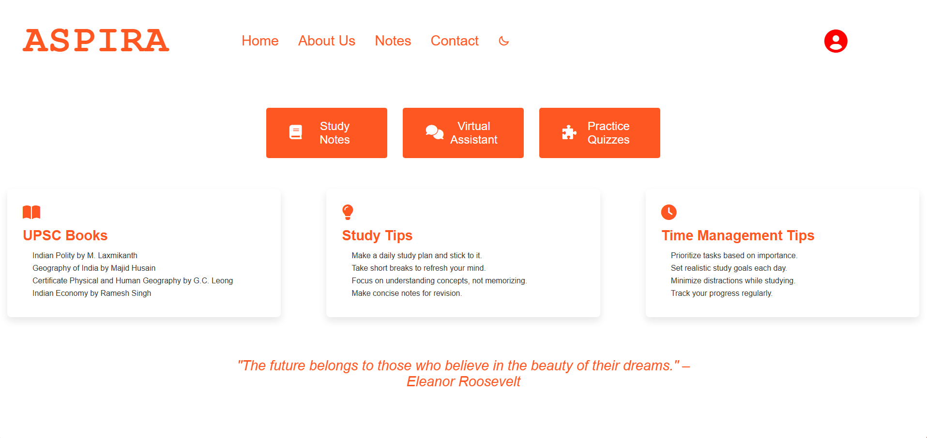
Implementation Screenshots
Fig. 2 : Homepage

Slide 11
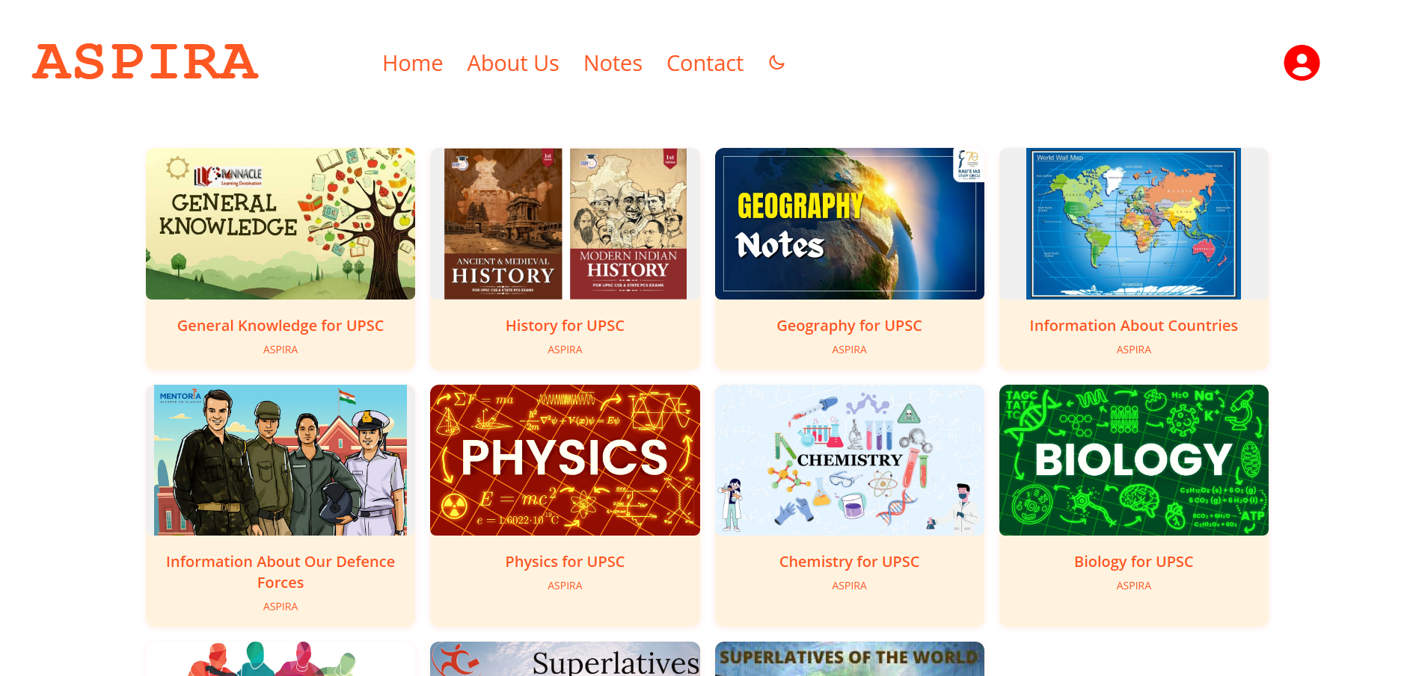
Fig. 3 : Notes Section

Slide 12
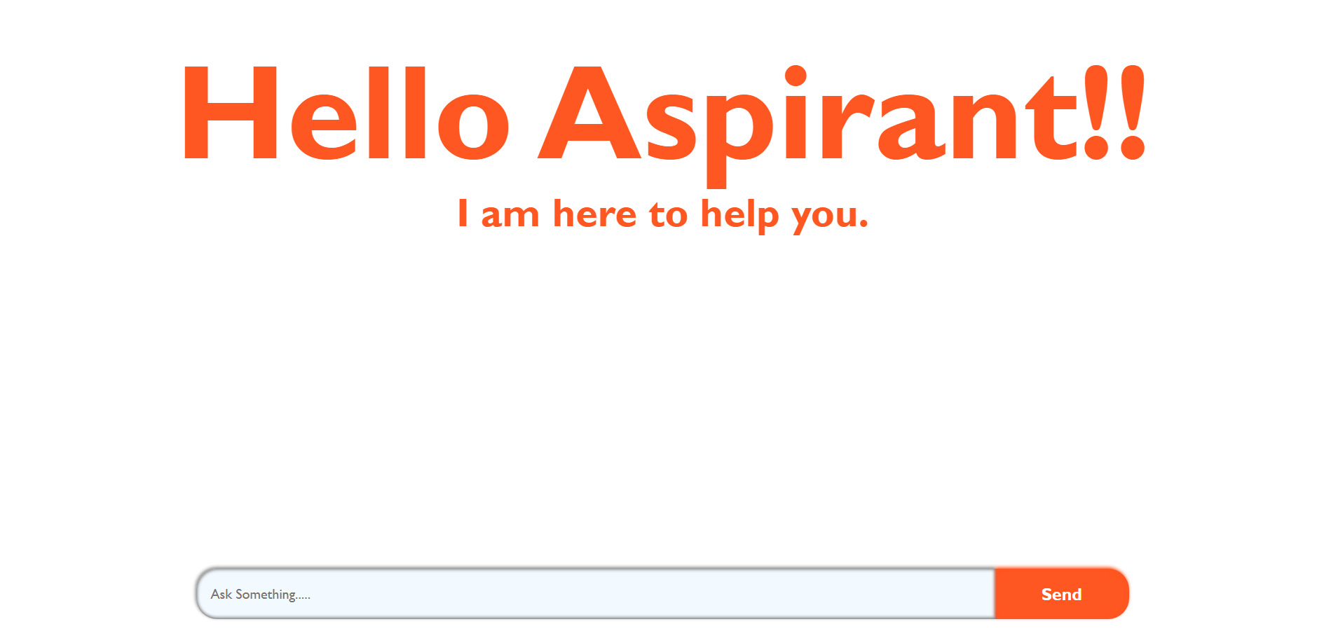
Fig. 4 : AI Chatbot

Slide 13
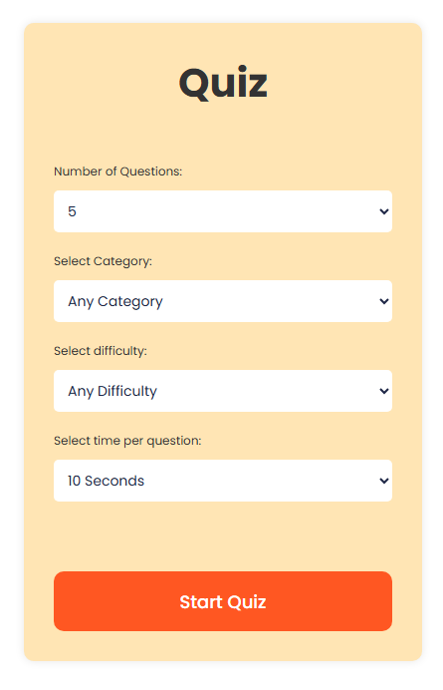
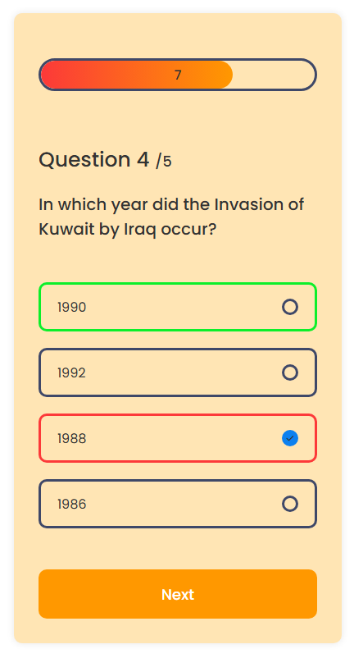
Fig. 5 : Quiz Section

Slide 14
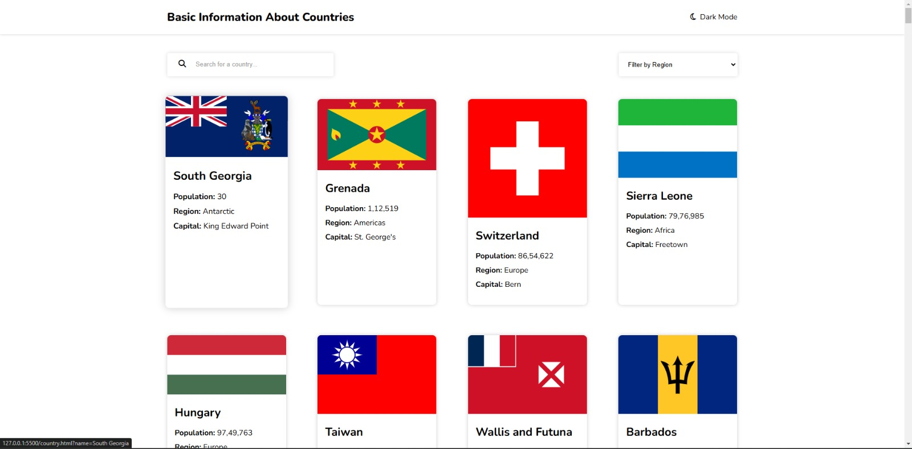
Fig. 6 : Geography Section

Slide 15
Conclusion
Our UPSC exam preparation platform is designed to provide aspirants with a structured, efficient, and personalized learning experience. By integrating AI-driven insights, comprehensive resources, and interactive tools, we aim to streamline the preparation process and enhance success rates. With a focus on holistic learning, real-time progress tracking, and adaptive study plans, the platform empowers candidates to achieve their goals with confidence and precision.

Slide 16
References
[1] Gamification and AI: Enhancing User Engagement through Intelligent Systems -Carlos J. Costa, Joao Tiago Aparicio, Manuela Aparicio, Sofia Aparicio (2024)
https://drive.google.com/file/d/1EuF_fT43h20ok2wMkFB2FGsgQVVcTEh_/view?usp=drive_link
[2] Adaptive Learning Using Artificial Intelligence in e-Learning: A Literature Review - Ilie Gligorea , Marius Cioca, Romana Oancea, Andra-Teodora Gorski, Hortensia Gorski and Paul Tudorache (2024)
https://drive.google.com/file/d/1UMRUOXfz8PkZzffbKYi9Yr-C4Cu1t1VW/view?usp=drive_link
[3] Gamified AI-Driven Assessments - Namya Joshi , Monica Joshi (2024)
https://drive.google.com/file/d/1yBbOR6ffz0DT5AWzpjeLdwy7A2SYxhOA/view?usp=drive_link
[4] Leveraging AI in E-Learning: Personalized Learning and Adaptive Assessment through Cognitive Neuropsychology—A Systematic Analysis - Constantinos Halkiopoulos and Evgenia Gkintoni (2024)
https://drive.google.com/file/d/1QdD1uXSLoSyDKS5V5dS9ToipkocNyF_r/view?usp=drive_link
[5] Analyzing the Impact of Gamification Techniques on Enhancing Learner Engagement, Motivation, and Knowledge Retention: A Structural Equation Modeling Approach - Lassaad Smirani and Hanaa Yamani (2024)
https://drive.google.com/file/d/18xmyvHehW6b_d8mVt40h4dmvlYbKZT14/view?usp=drive_link

Slide 17

Thank You...!!
Notes:
17

